Slide 1
Material Property Evolution
NE 591

Slide 2
Last Time
Wrapped up thermomechanics
Overviewed US fuel performance codes
Notes:
No class on 2/25, conference travel
Presentations on 2/27

Slide 3
Pretty much everything we have learned so far, nothing changes once the fuel and cladding reach steady state

Slide 4
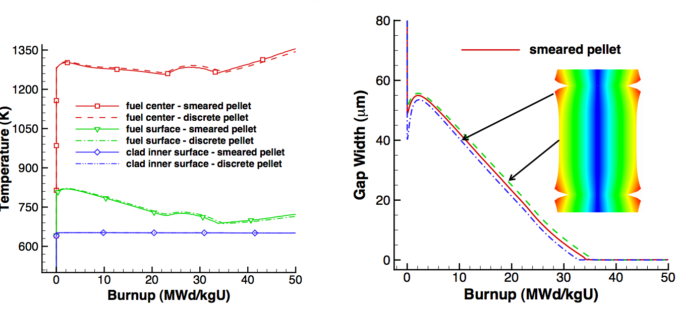
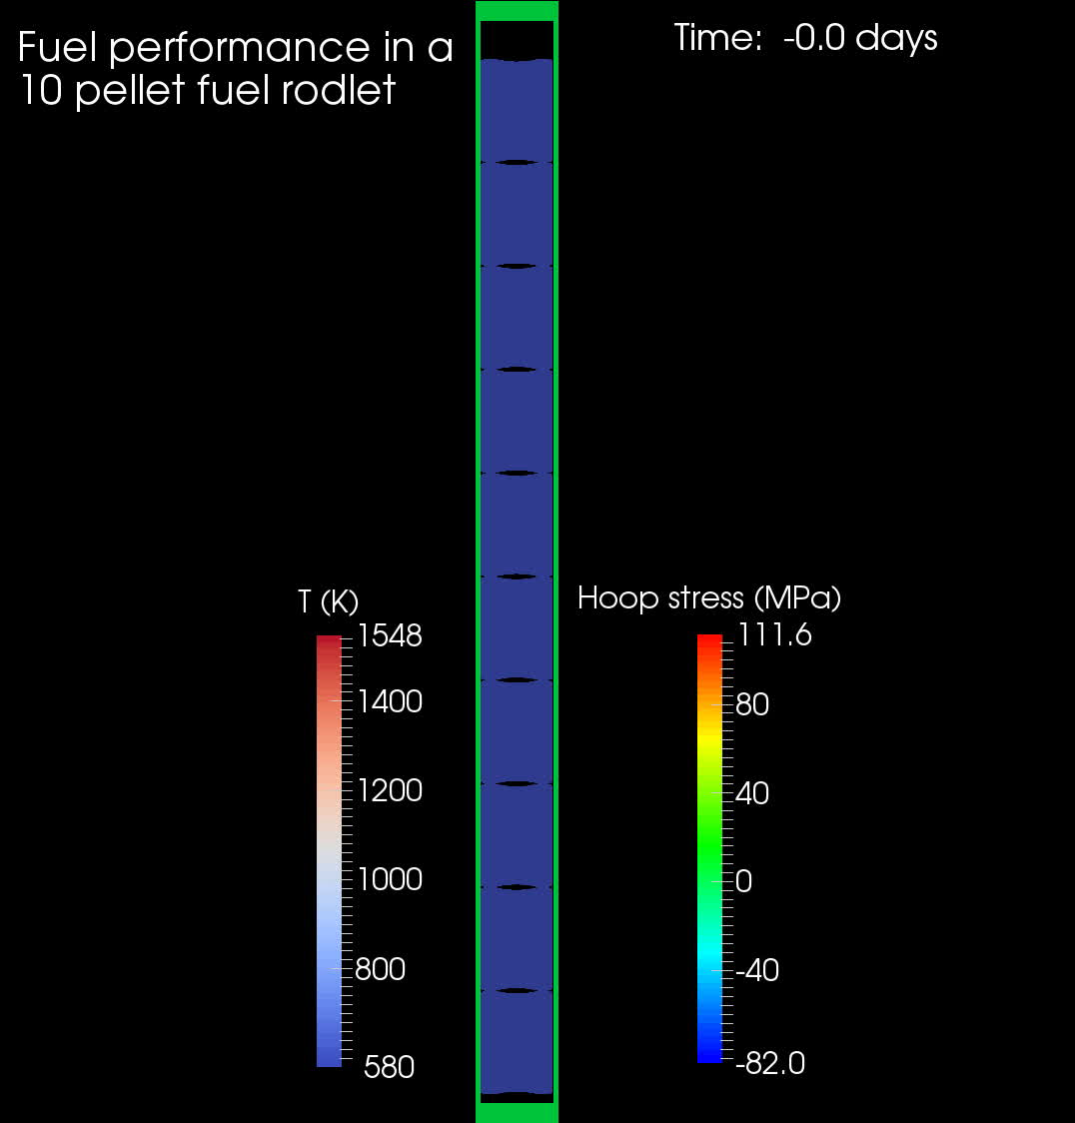
Fuel is dynamic!

Slide 5
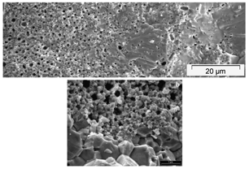
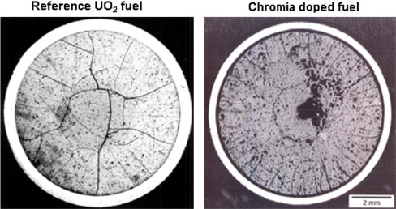
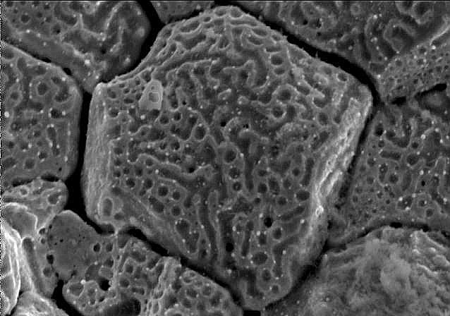
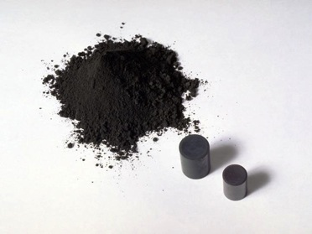
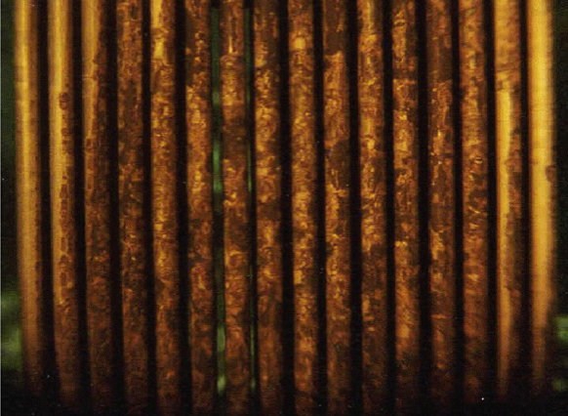
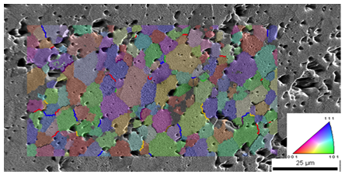
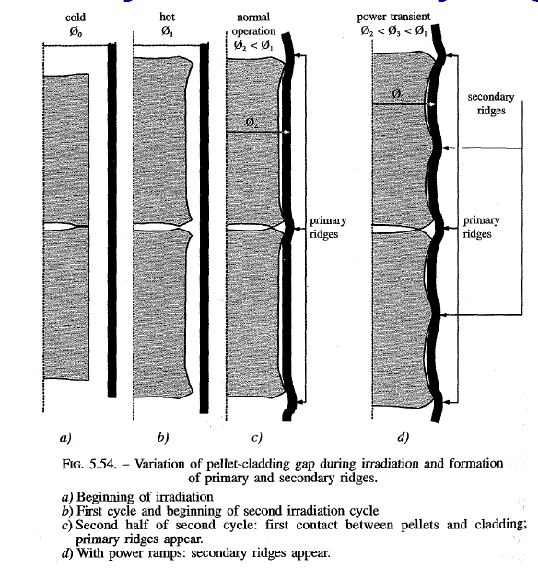
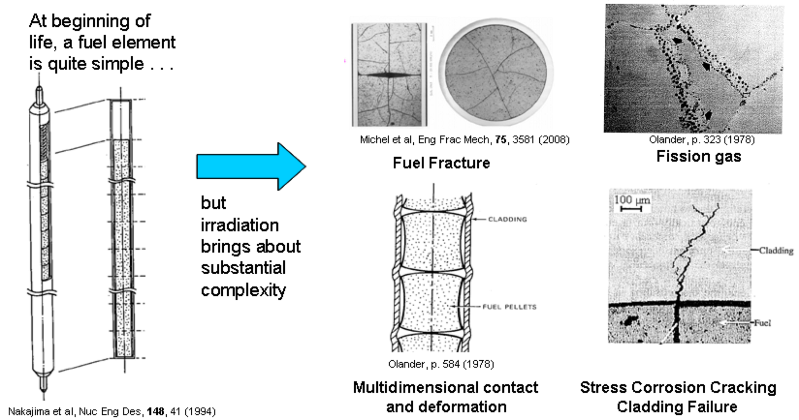
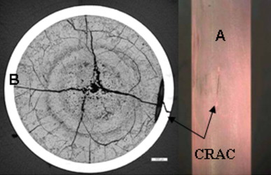
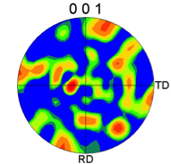
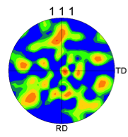
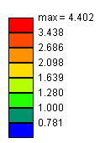
Property changes due to microstructure evolution during reactor operation must be considered
Insertion in reactor
Removal from reactor
Early life
Thermal expansion
Fracture
Point defect and fission gas generation
Fuel Densification
Mid Life
Point defect diffusion
Point defect clustering
Fission gas segregation to GB and voids
Bubble nucleation
Late life
Fission product swelling
Bubble percolation and fission gas release
Cladding creep
Fuel creep
Fuel failure
Pellet/cladding interaction
Cladding corrosion
Cladding fracture
Fuel Fabrication
Sintered UO²
Height 2 cm
Diameter 1 cm
~10 μm grain size
Density > 95%
Brohan 2000
From Pedro Peralta, ASU
Zinkle and Singh 2000
Santana et al. 2011

Slide 6
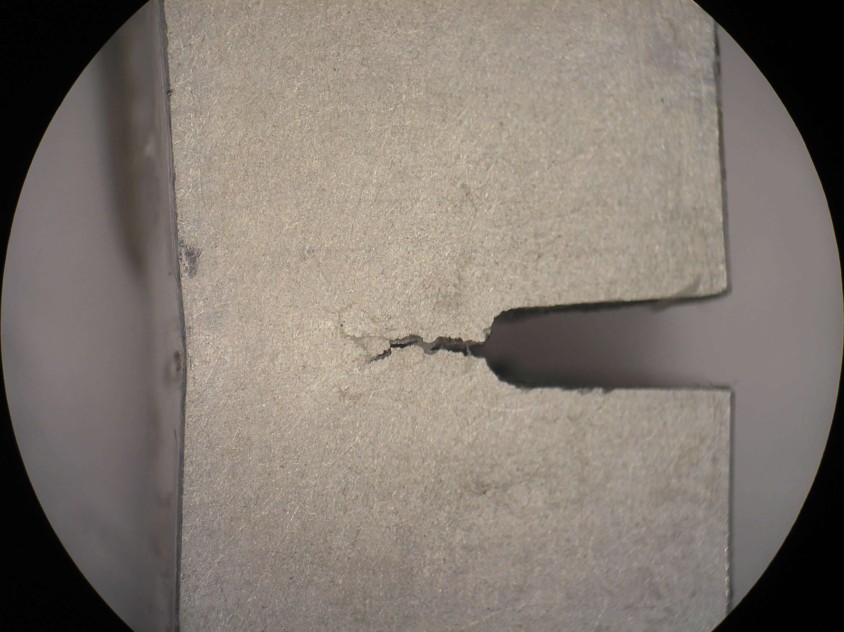
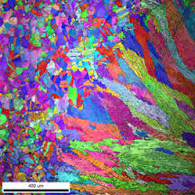
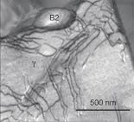
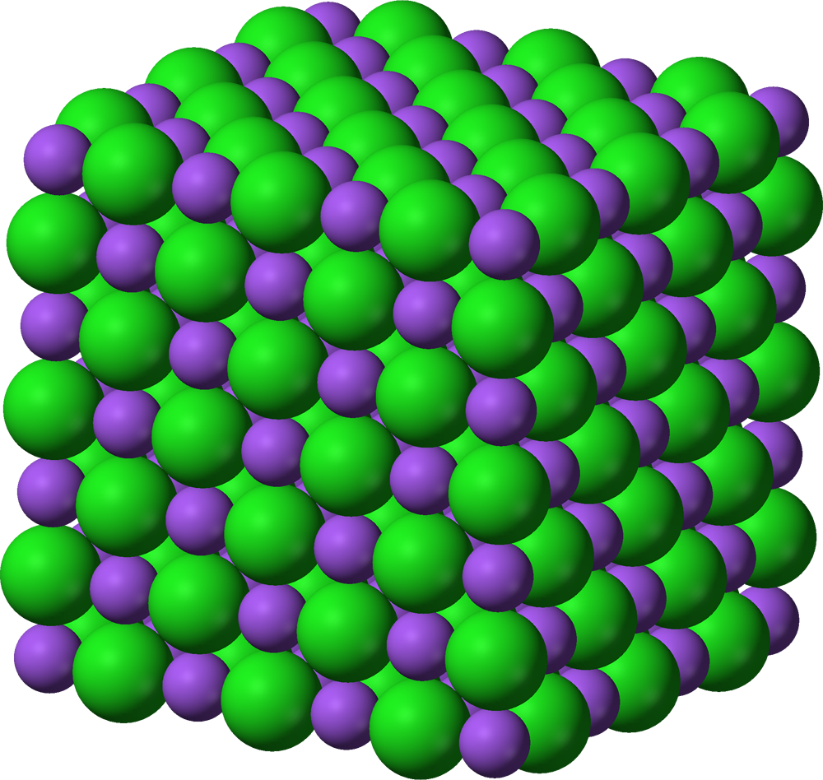
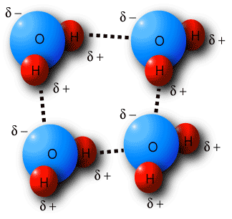
The properties and performance of a material are a result of factors across various length scales
Material properties and performance
Microstructure
Defect interactions
Crystal structure
Chemical bonds

Slide 7
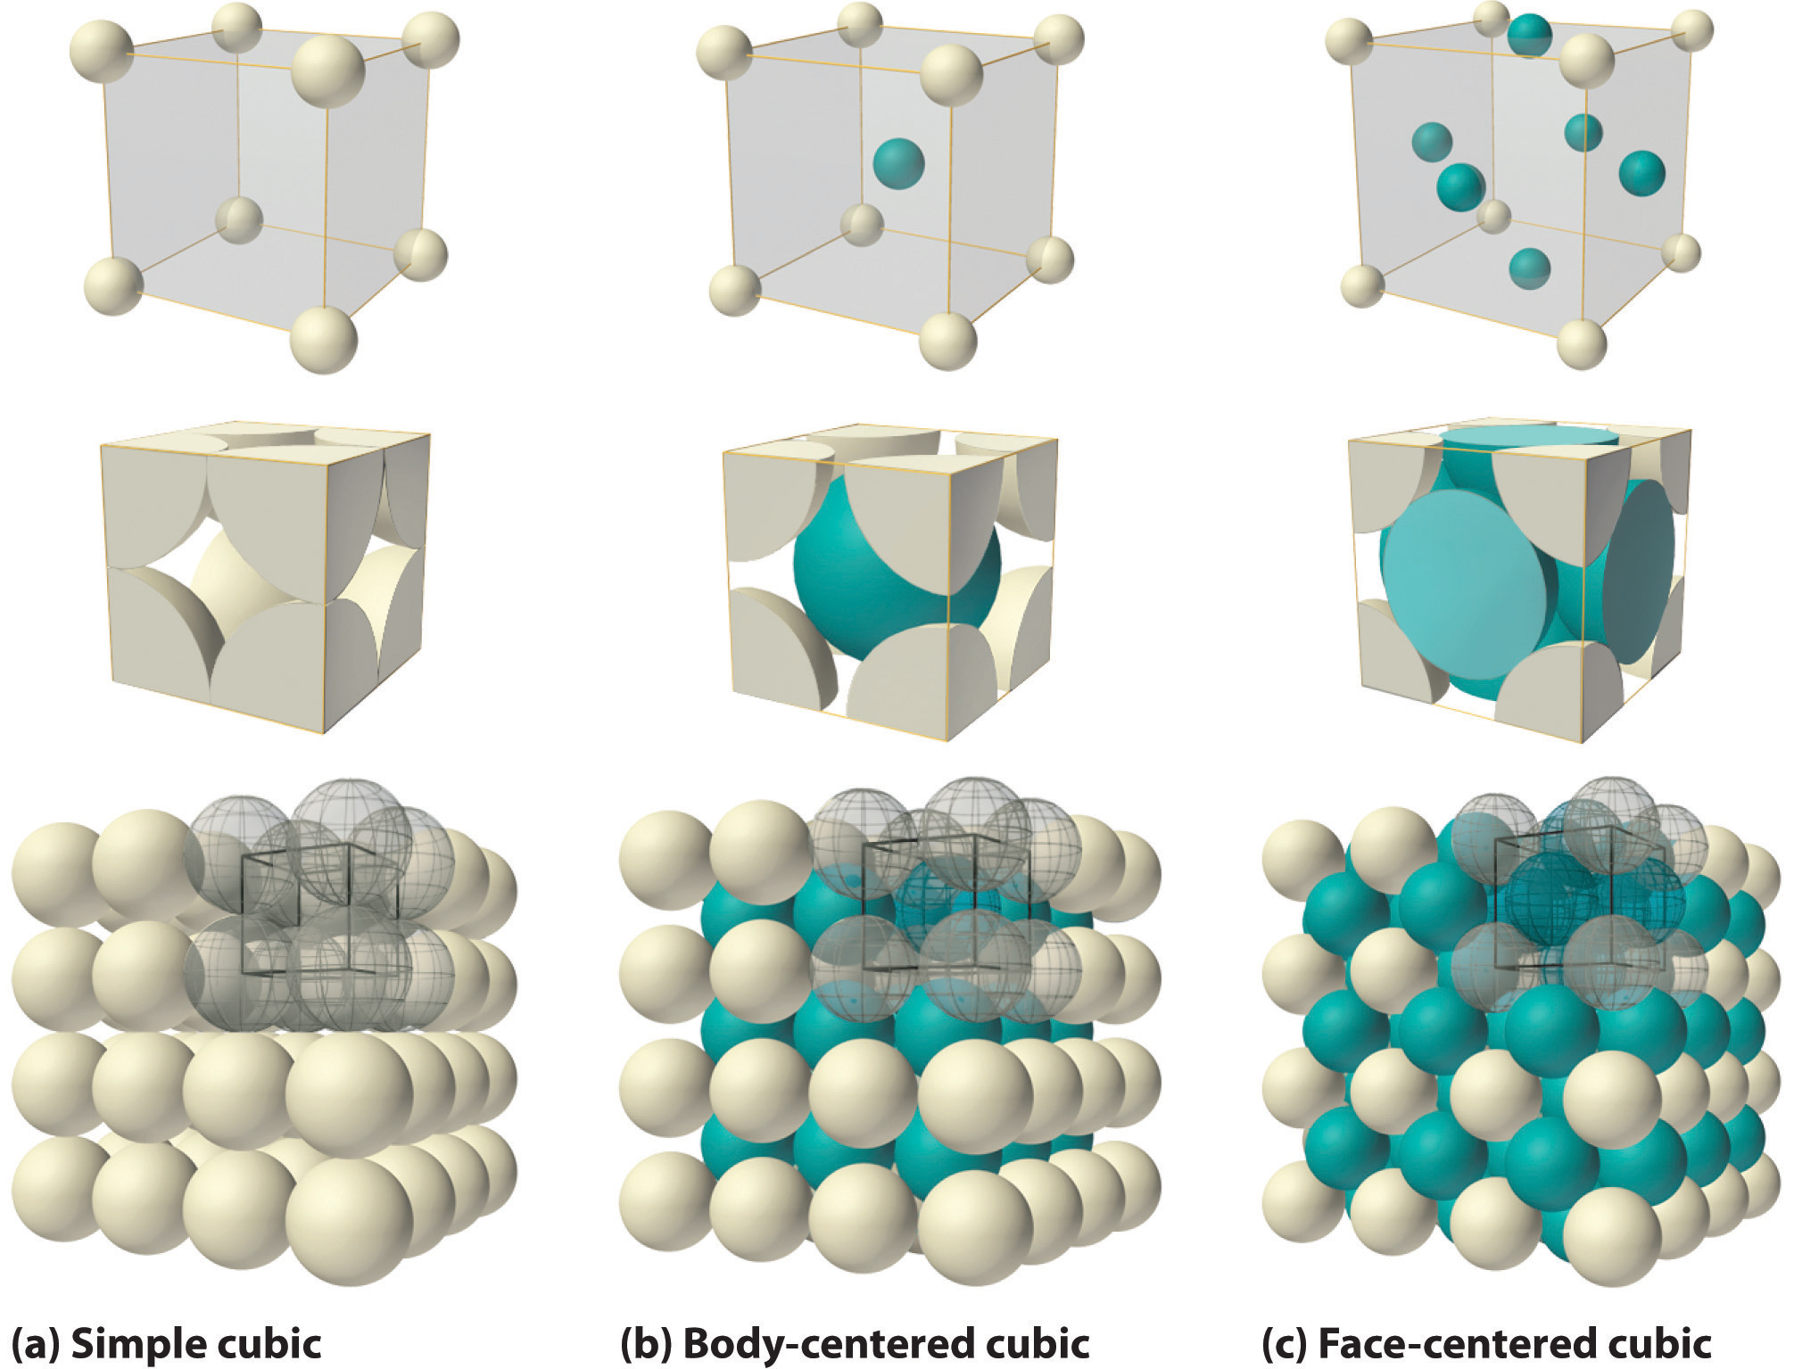
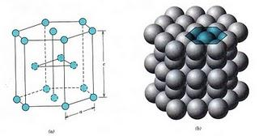
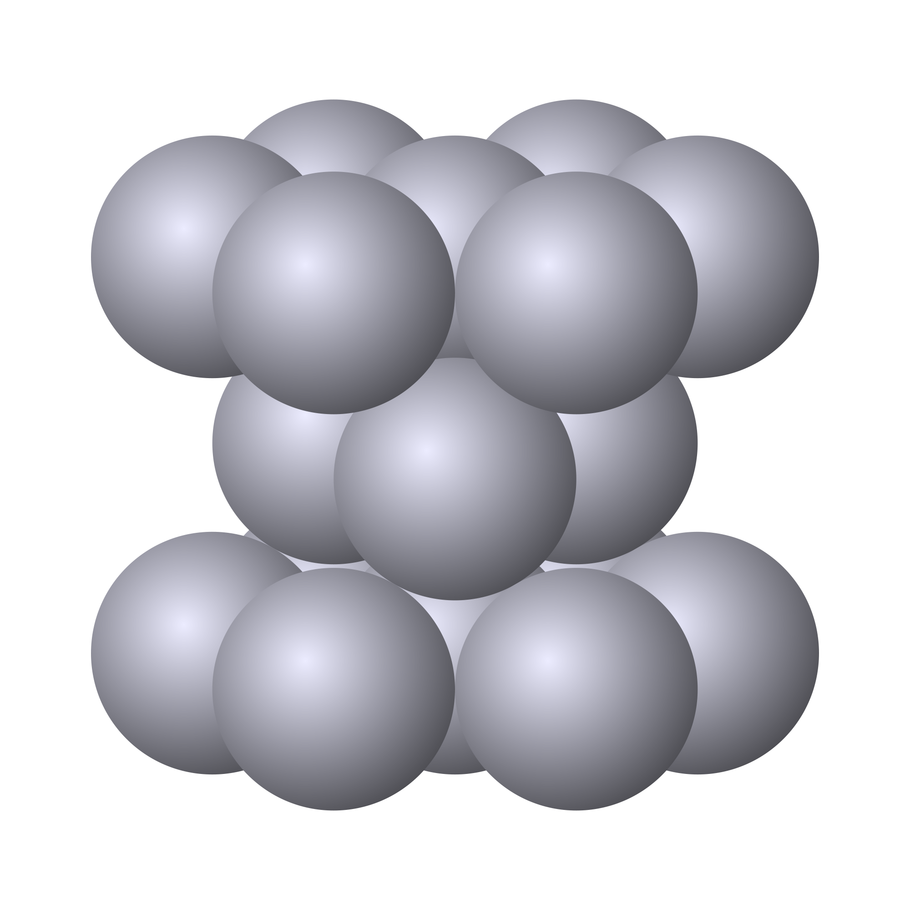
The crystal structure of a material is the shape of the ordered structure of the atoms
The atoms of many materials form an organized lattice, these are called crystalline materials. All reactor materials are crystalline.
The configuration of the atoms in the lattice impacts the properties of the material (density, thermal expansion coefficient, elastic modulus, etc.)
All major light water nuclear materials are either cubic or hexagonal
(d) Hexagonal close packed

Slide 8
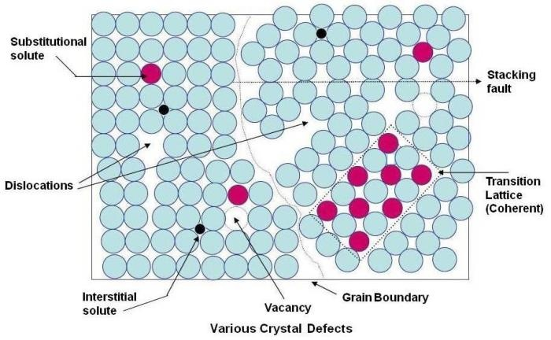
Crystalline materials
In crystalline materials, the lattices are not perfect, they have defects
Defects can be 0D, 1D, 2D, 3D
The interactions between defects seriously impact material properties and how they perform

Slide 9
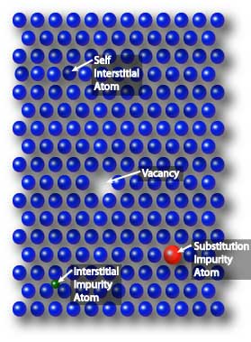
Point defects
Point defects (zero-dimensional defects) are lattice imperfections related to one or two lattice sites
There are several types of point defects
Vacancies
Self interstitial atoms (SIA)
Interstitial impurity atoms
Substitutional impurity atoms
Point defects control the mobility of atoms and, therefore influence all processes that depend on diffusion

Slide 10
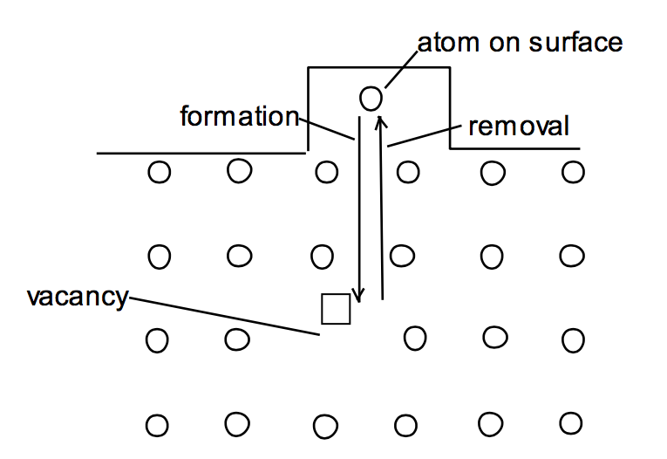
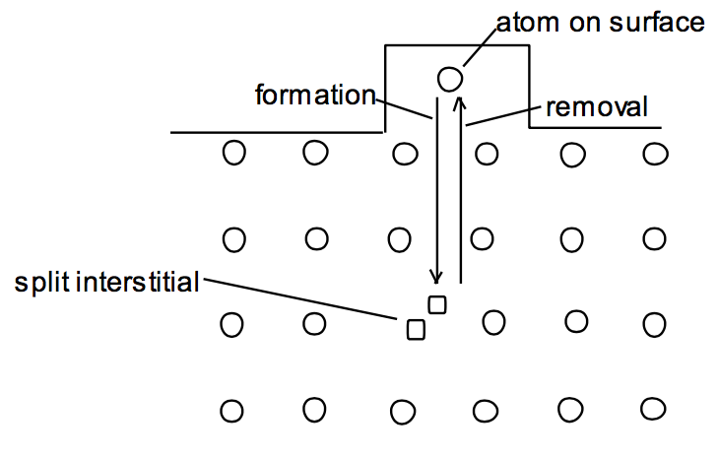
Point defects
Vacancies and interstitials form naturally in materials
Extra atoms can sit on a surface, creating a vacancy, or a surface can have a missing atom, creating a self interstitial atom (SIA)
We define the number of vacancies or interstitials in terms of a concentration
There exists an equilibrium concentration of point defects

Slide 11
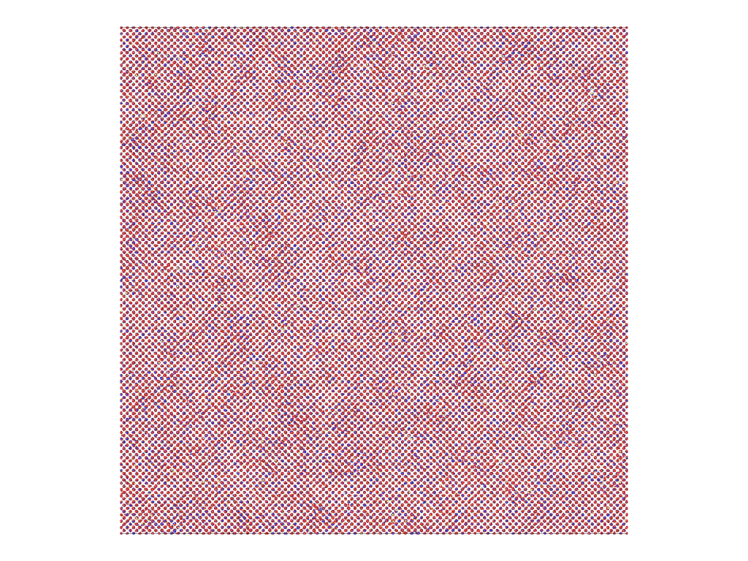
Radiation damage
Ionizing radiation can introduce defects into the crystal lattice, called radiation damage
PKA collisions create a collision cascade, which results in the generation of defects (point and clusters)

Slide 12
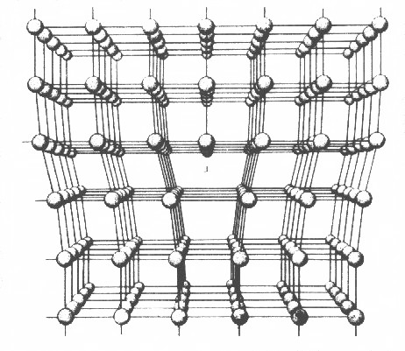
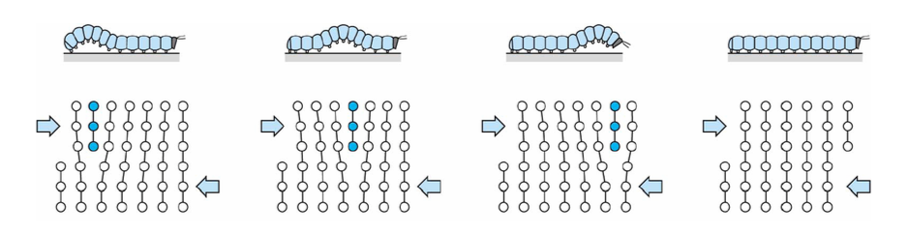
Dislocations are imperfections associated with a line of lattice sites (1D defect)
In a dislocation, an extra half plane of atoms is inserted into the lattice
When it moves, only a small number of bonds are broken at a time
Dislocation motion controls the plastic (permanent) deformation of crystalline materials

Slide 13
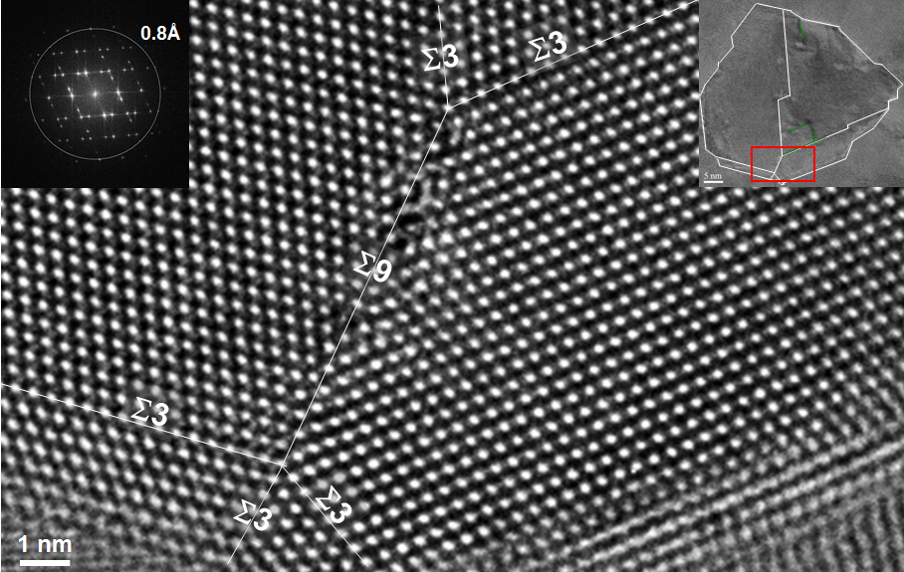
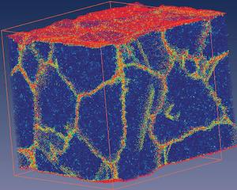
Grain boundaries
Materials are typically composed of various regions where the crystal lattice is oriented differently. These regions are called grains
When two grains meet, there is a plane of atoms that do not follow the crystal lattice called a grain boundary
Most crystalline materials are polycrystalline, not single crystal
High-res transmission eleectron microscopy can also show individual atoms (palladium)
www.knmf.kit.edu/TEM.php
Atomistic simulation of grain boundaries in 3D

Slide 14
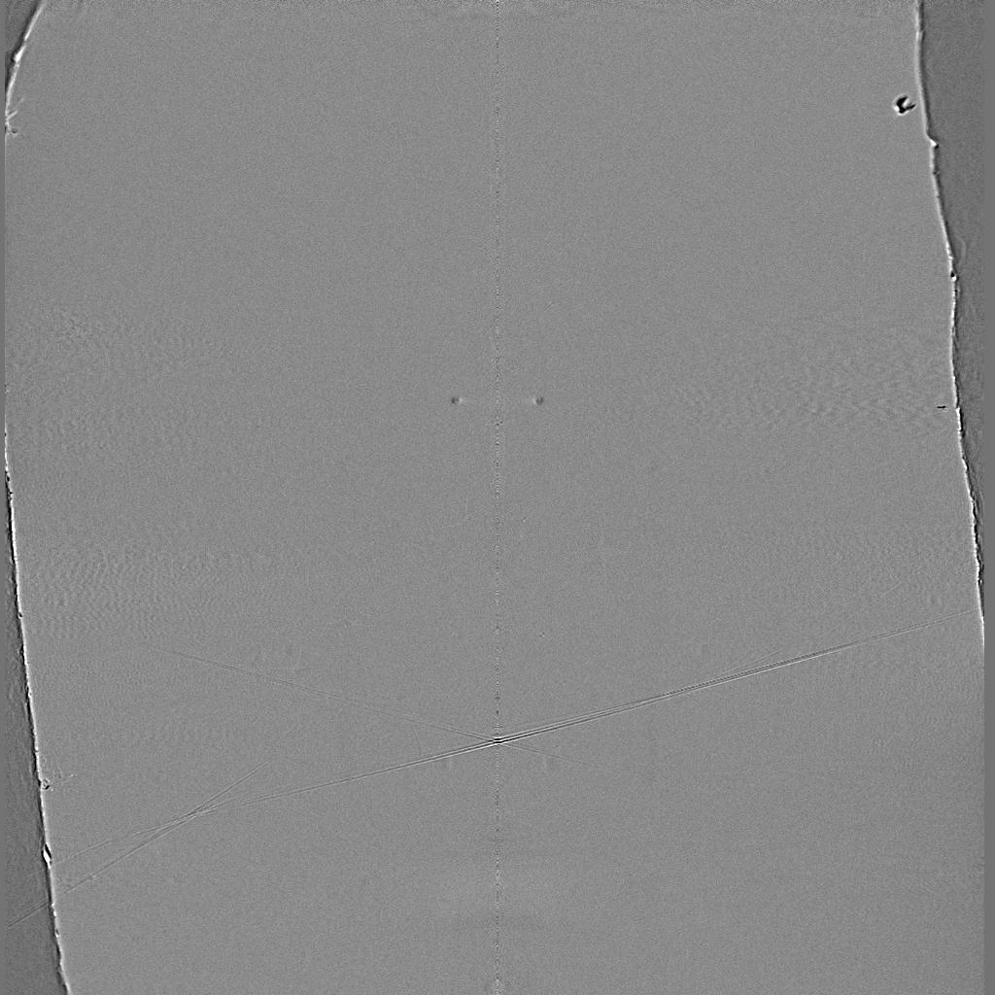
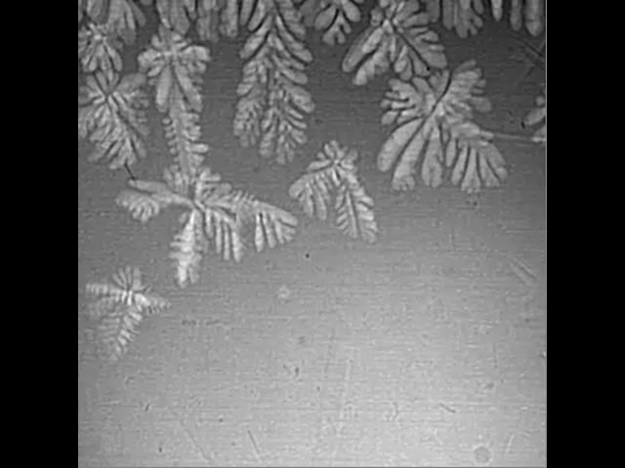
Metals are often cast, and polycrystals naturally form during casting

Slide 15
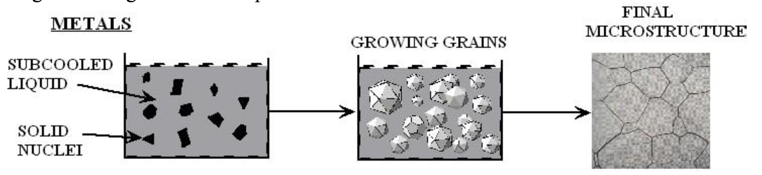
Polycrystals naturally form during casting
Solidification begins in different regions of the melt, each with a different orientation
Once the different regions meet, grain boundaries form between them

Slide 16
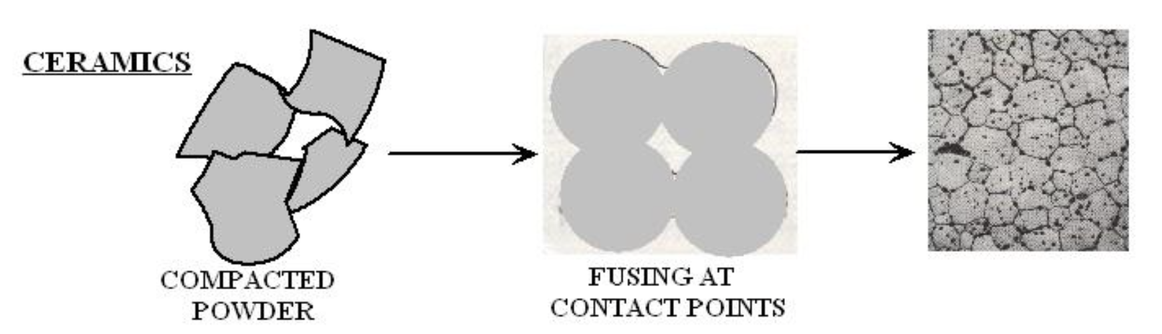
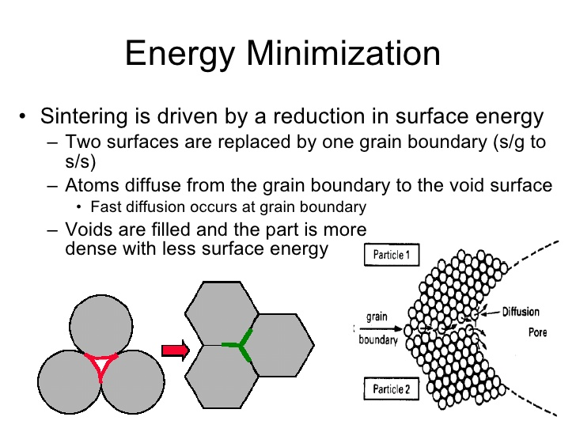
Ceramic sintering
Ceramics are typically sintered, and polycrystals also naturally form from sintering
In sintering, powders are compacted at high temperature
The particles are each oriented differently, and as the fuse, grain boundaries form
The differences between the grain orientations result in the grain boundary

Slide 17
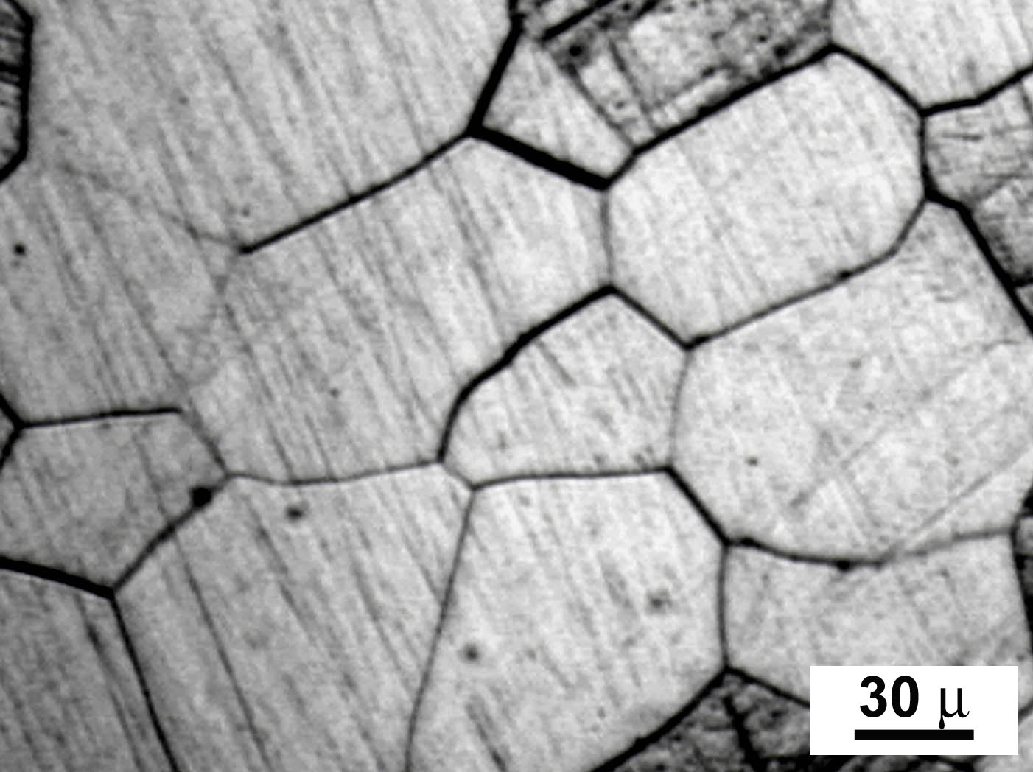
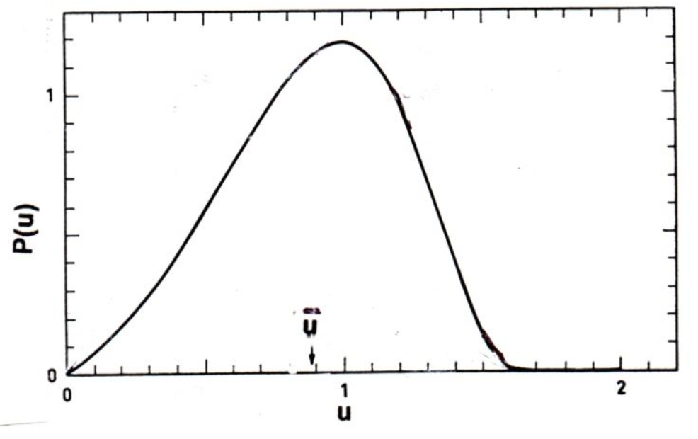
Distribution of grain sizes
In a polycrystal, there is also a distribution of grain sizes
Therefore, we commonly refer to the grain size distribution and the average grain size
The Hillert distribution is an analytical distribution for grain size
Real materials often vary from this behavior

Slide 18
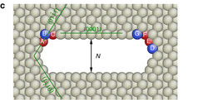
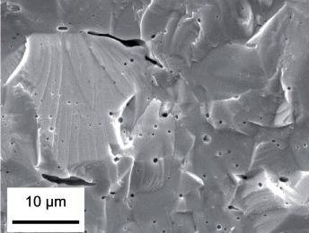
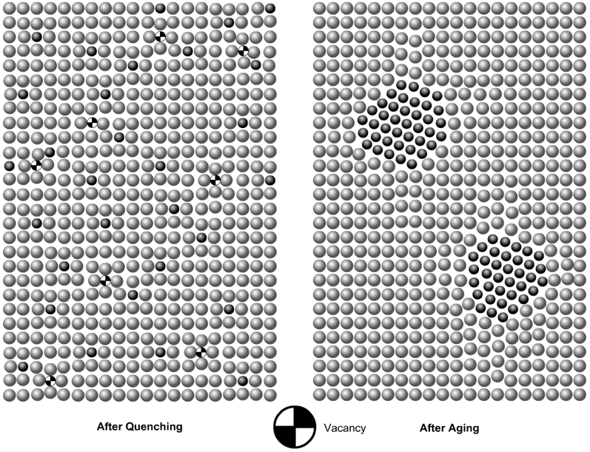
3D Defects
When point defects cluster, they form three dimensional defects
The energy of a point defects is reduced when several point defects cluster together
Larger clusters of vacancies are called voids
Clusters of impurity atoms are called precipitates

Slide 19
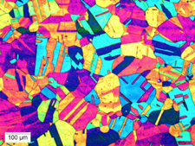
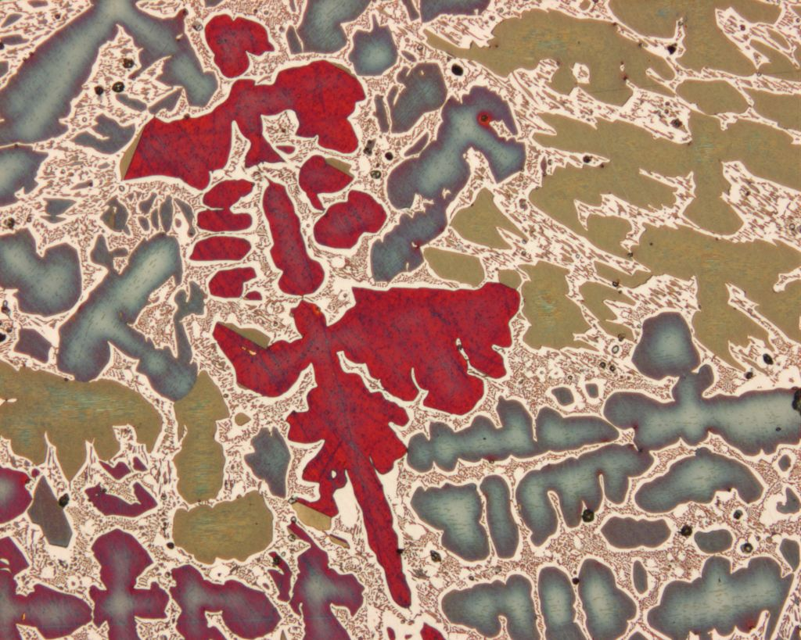
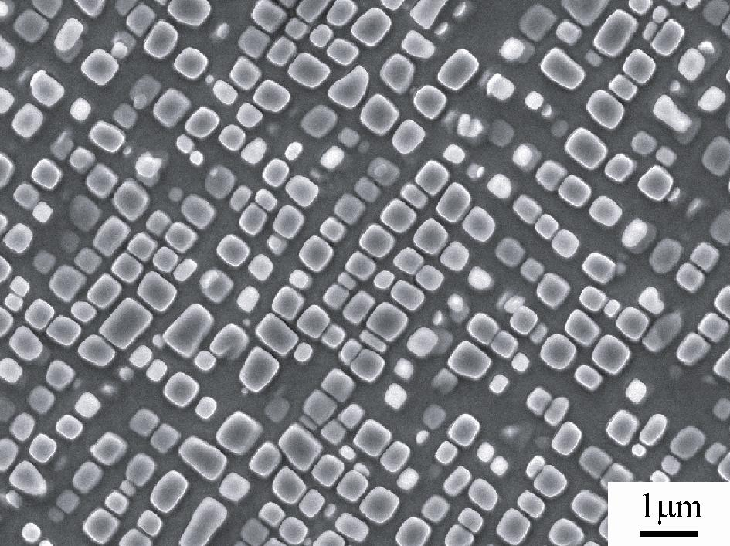
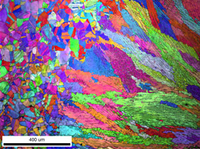
Microstructure
Material microstructure is the structure observable with 25x magnification
The microstructure includes grain structure, secondary phases, porosity, and more
The microstructure can strongly influence physical properties such as strength, toughness, ductility, hardness, corrosion resistance, high/low temperature behavior or wear resistance.
These properties in turn govern the application of these materials in industrial practice
Annealed Stainless Steel
Cast Bronze
Sintered UO2
Co-Al-W Superalloy
Friction stir welded stainless steel

Slide 20
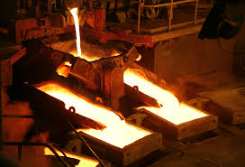
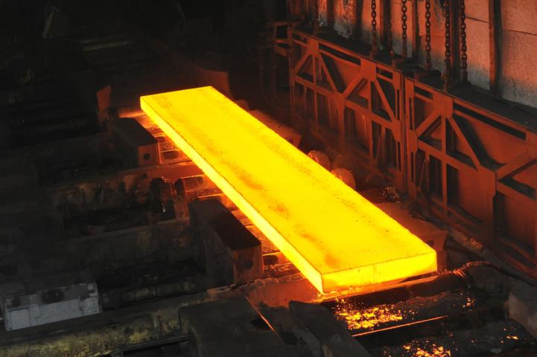
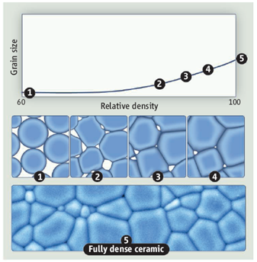
Material processing
The process we use to make a material has a huge impact on its microstructure and properties
Casting – manufacturing process in which a liquid material is poured into a mold and then allowed to solidify
Can be used to make complex shapes
The solidified microstructure typically has properties that are far from ideal
Sintering – Forming a solid from a powder using heat and/or pressure without melting the material
Applicable to metals and ceramics
Difficult to obtain a material that is fully dense
Used to make fuel pellets
Heat treatment – heating or cooling a material to extreme temperatures to get desired microstructure and properties
Used to control the rate of microstructure change, including diffusion, grain growth, or phase change
Use on many types of materials (metals, ceramics, glasses)

Slide 21
Summary
Even during steady state operation, fuel and pellet conditions change with time due to microstructure evolution
Atoms in the fuel and cladding materials are arranged in a crystal lattice
The crystal lattice is never perfect; it has defects
Point defects include vacancies, interstitials, and impurity atoms
Dislocations are line defects
Grain boundaries are planar defects
Voids and precipitates are volume defects
All materials have defects
Radiation damage causes many more defects

Slide 22
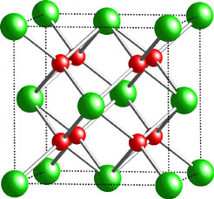
Fuel Chemistry
UO₂ is an ionic compound that must have balanced charges
What is the charge of a typical oxygen ion?
O²⁻
Uranium valance states
Possible: U³⁺, U⁴⁺, U⁵⁺, U⁶⁺
Most stable: U⁴⁺, U⁵⁺, U⁶⁺
The structure is very stable all the way up to the melting temperature and down to extremely low temperatures, even with irradiation damage
There is space in the uranium lattice that can accommodate fission products

Slide 23
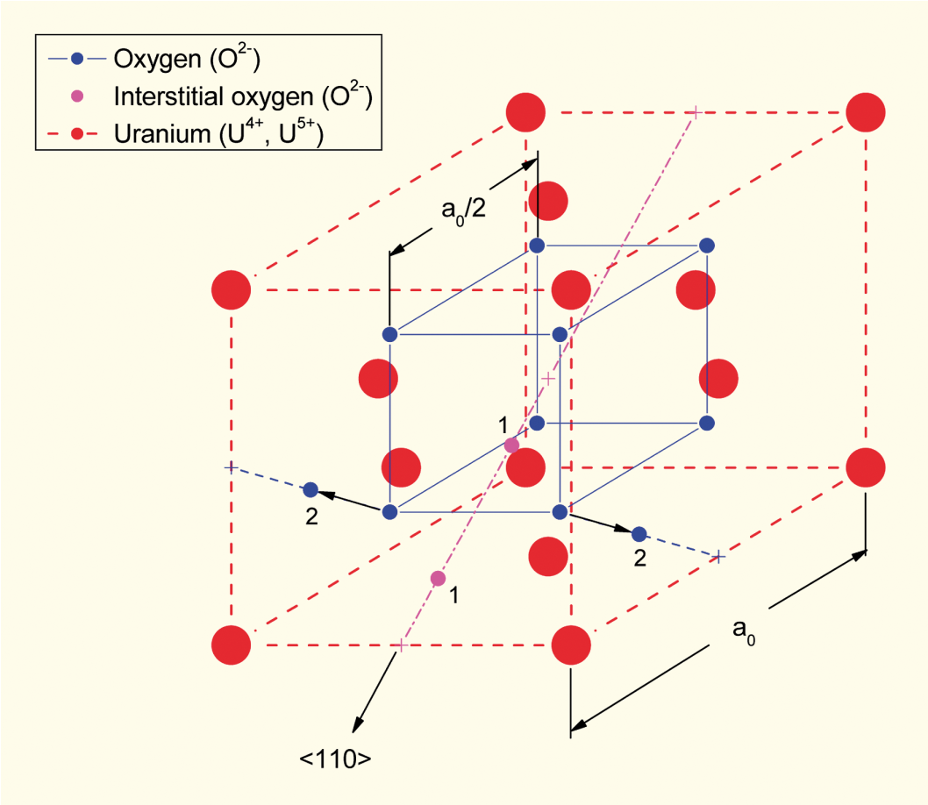
Excess O
The crystal structure of UO₂ can also accommodate extra oxygen
Excess oxygen resides at interstitial locations
Oxygen in neighboring sites is displaced
Cation valence increases to maintain electrical neutrality
[after Olander, 1976]

Slide 24

O/M ratio
The ratio of oxygen to uranium metal (O/M ratio) can vary
This is the stoichiometry
Fuel fabricated to be nearly stoichiometric; i.e., UO2.00± because:
It is the most stable
It has the highest melting temperature
Will the O/M ratio go up or down during reactor operation?
It is complicated, because of the formation of fission products that also react with the oxygen

Slide 25
Next time
Continuing fuel chemistry
Working through grain growth

